Slide 1
OECD findings: How governments are shaping multi-disciplinary responses to gender-based and domestic violence
Doron Wijker
7th International EFJCA Conference, 2025
6 October 2025

Slide 2
Violence against women: A growing priority for governments
% OECD governments ranking issue as top-three gender equality priority, 2016
Source: Adapted from OECD (2017), The Pursuit of Gender Equality. Based on responses from 31 OECD countries to the 2016 OECD Questionnaire on Progress in Implementing the 2013 Gender Recommendation.

Slide 3
Violence against women: A growing priority for governments
% OECD governments ranking issue as top-three gender equality priority, 2024
Source: OECD (2025). Supports th(at) work: Policy tools to support workplace action on intimate partner violence. Based on responses from 38 OECD countries to the 2024 OECD Questionnaire on Policy Combinations for Gender Equality and/or the 2021 OECD Gender Equality Questionnaire.

Slide 4
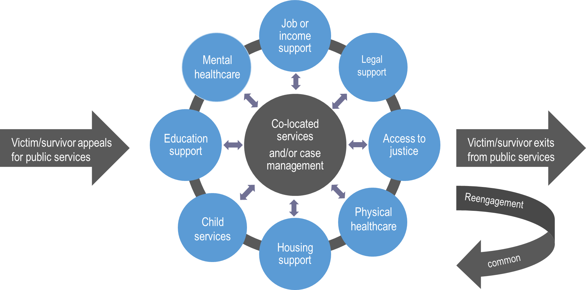
Promoting integrated service delivery
Simple model of integrated service delivery to address intimate partner violence
Source: OECD (2023). Supporting Lives Free from Intimate Partner Violence: Towards Better Integration of Services for Victim/Survivors.

Slide 5





Safe housing to break the cycle of violence
Emergency shelters common for those in crisis. Some countries offer co-located services in shelters, but supply is inadequate and there is geographic inequality
Low supply of longer-term housing (e.g. social housing) for victim-survivors exiting emergency shelters
Some promising practises
Priority access to social housing for victim-survivors: e.g. Belgium, Ireland, Japan, the Netherlands, Portugal
Efforts to improve supply of emergency and/or longer-term housing, e.g. France
Programmes to enable victim-survivors to stay safely in their own home, e.g. Australia
Emergency housing (+co-located services)
Integrated services diminish over time

Slide 6
Addressing the costs of violence: job and income support
Income support: various targeted income provisions are offered to victim-survivors: e.g. Australia, Costa Rica, Estonia, Greece, Italy, Korea, Latvia, Portugal, Slovenia, Spain, Switzerland
Employment support: some countries have offered dedicated employment support for victim-survivors, e.g. Costa Rica, Spain, UK
Workplace support: employers taking action
Government measures focused on:
Entitlements for workers: employment protection, flexible working arrangements, domestic violence leaves
Measures for firms: guidance, good practice recognition, reviewing employer responsibilities
National, paid domestic violence leave entitlements (OECD)
 | Days | Eligibility | Evidence?
Australia | 10 | All full-time, part-time and casual employees | Can be requested
Canada | 5 | Public sector, >3 months employment | Can be requested
Ireland | 5 | All employees | None
Italy | 90* | Female employees certified in protection programme | Municipal certification
New Zealand | 10 | Employees with >6 months employment | Can be requested
Slovenia | 5 | Employees with ongoing proceedings | Certification
UK (Northern Ireland only) | 10 | Forthcoming, all workers | TBD
Source: Simplified from OECD (2025). Supports (th)at work: Policy tools to support workplace action on intimate partner violence. Not all eligibility requirements are shown. *In Italy, can be taken over three years.

Slide 7
Promoting prevention and justice
% of women who have experienced intimate partner violence and non-partner violence, by person or support service to whom the violence was reported, EU, 2021
Source: OECD (2025). Gender Equality in a Changing World: Taking Stock and Moving Forward. In collaboration with DG JUST. Data from Eurostat, based on 2021 wave of the EU-GBV survey. EU averages are unweighted.
Building confidence in reporting
Supporting integrated service delivery for those who do report: e.g. multi-disciplinary risk assessment, robust information sharing

Slide 8








Thank You
Links
Gender-based violence: https://www.oecd.org/en/topics/sub-issues/gender-based-violence
Truth Hurts podcast series: https://www.oecd.org/en/about/projects/truth-hurts-oecd-talk-series-on-preventing-violence-against-women.html -
Contact: Doron Wijker, Monika Queisser
Source:

Slide 9
Thank You

